Slide 1

Truthful auction mechanisms for resource allocation in the Internet of Vehicles with public blockchain networks
Under the Supervision of Presented By:
Dr. Anshul Verma Sagar Timalsena
(24419CMP025)

Slide 2
Overview
Blockchain
Transaction Management in Blockchain
Vehicular Blockchain Network
Consensus
Need for Edge Resource Allocation
Auction System
Paper Details

Slide 3

Blockchain
🧾 Distributed Ledger:
Data is shared across multiple computers (nodes) for transparency and reliability.
🔒 Immutability:
Once recorded, information cannot be changed or deleted.
🌐 Decentralization:
No central authority — all participants verify transactions.
🧠 Secure by Cryptography:
Uses encryption to protect data and ensure trust.

Slide 4
Advantage Of Blockchain
High Security
Transparency
Fast and Efficient
Cost Reduction
Traceability

Slide 5
💰 Transaction Management in Blockchain
Refers to the process of handling and verifying transactions in the blockchain network.
Each transaction is validated by miners or nodes before being added to a block.
Ensures accuracy, consistency, and security of all recorded data.
Once confirmed, the transaction becomes permanent and tamper-proof in the ledger.

Slide 6
📱 Vehicular Blockchain Network
Combines blockchain technology with moving devices.
Each vehicle acts as a node to store and verify data.
Enables secure, decentralized communication between vehicles.
Supports trusted data sharing and payments.

Slide 7
⚙️ Consensus
Agreement process among all blockchain nodes.
Ensures only valid transactions are added to the ledger.
Maintains one shared and trusted version of the blockchain.
Provides security and reliability in a decentralized network.

Slide 8
Types of Consensus Mechanisms
Proof of Works(POW):
  Miners solve complex puzzles to validate transactions.
  High energy consumption due to heavy computations.
  Rewards miners with cryptocurrency.
  Used in Bitcoin; secure but slower.

Slide 9
Continue...
2. Proof of Stake(POS)
Validators are chosen based on the number of coins they stake.
Energy-efficient; no complex puzzles like POW.
Rewards are distributed proportionally to the stake.
Used in Ethereum 2.0, Cardano, and other modern blockchains.

Slide 10
🌐Need for Edge Resource Allocation
Edge-level computing provider delivering CPU, storage, and network.
Processes data locally, reducing latency.
Supports blockchain and IoT applications with resources.
Bridges users and cloud, acting as a nearby mini data center.

Slide 11
💸 Auction System
Bidding-based mechanism for buying or selling resources.
Participants place bids to compete for limited assets.
Ensures fair, transparent, and efficient allocation.
Widely used in blockchain and IoV for resource management.

Slide 12
🏷️ Types Of Auction System
English Auction
Dutch Auction
First Price Auction
Second Price(Vickrey) Auction
Double Auction

Slide 13
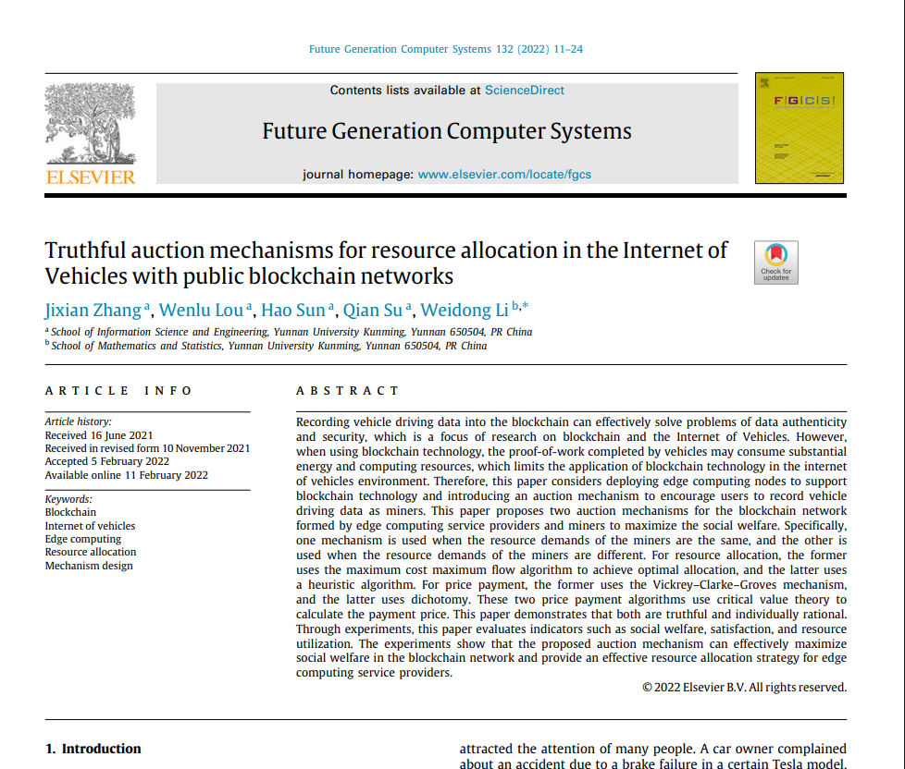
Paper Description

Slide 14
Objective
Efficient Resource Allocation
Truthful Auction Design
Weighted Resource Model
Profit Optimization
Blockchain Transparency

Slide 15
Experimental Parameters
Constant-Demand Auction Mechanism (CDAM)
Designed for blockchain-based IoV systems where all miners have the same demand (di = 1)
  Objective: Maximize social welfare through efficient resource allocation
  Allocation: Uses Maximum Cost Maximum Flow Algorithm for optimal distribution
  Pricing: Applies Vickrey–Clarke–Groves (VCG) mechanism to ensure truthful bidding

Slide 16
2. Multi-Demand Auction Mechanism (MDAM)
Designed for blockchain-based IoV systems where miners have different resource demands (di ≠ 1)
Objective: Maximize social welfare while handling variable resource requirements
Problem type: NP-hard (cannot find exact optimal solution in polynomial time)
Uses heuristic approach for near-optimal performance

Slide 17
Further Work
1. Implement CDAM and MDAM
2. Compare Their Social Profit

Slide 18
References
J. Zhang, W. Lou, H. Sun, Q. Su, and W. Li, "Truthful auction mechanisms for resource allocation in the Internet of Vehicles with public blockchain networks," *Future Gener. Comput. System, vol. 132, pp. 1–13, 2022, doi: 10.1016/j.future.2022.01.004.
S. Wang, J. Wang, X. Wang, et al., “Blockchain-Powered Parallel Healthcare Systems Based on the ACP Approach,” IEEE Transactions on Computational Social Systems, pp. 942–950, 2018.
J. Q. Huang, L. H. Kong, G. H. Chen, et al., “Towards Secure Industrial IoT: Blockchain System with Credit-Based Consensus Mechanism,” IEEE Transactions on Industrial Informatics, pp. 1–10, 2019

Slide 19

Thank You!!

